Slide 1
Online open Day
1 giugno 2023

Slide 2
Master Program in
Molecular Biotechnology
School of Medicine
Dept Molecular Biotechnology and Health Sciences

Slide 3
Master Program in
Molecular Biotechnology
What is Molecular Biotechnology?
In its broadest sense, molecular biotechnology is the use of laboratory techniques to study and modify nucleic acids, proteins and cell metabolites for applications in areas such as human and animal health, agriculture, and the environment.

Slide 4
The Master program in Molecular Biotechnology is aimed at graduate students (from such fields as biotechnology, biology, chemistry, pharmacy) with a strong background in cell biology, molecular biology, genetics, inorganic and organic chemistry, and biochemistry.
This Master is opened to students of the BioHealth Computing EM program (EU Master) coming from worldwide.

Slide 5
Both basic and applied biomedical research have an increasing demand for modern interdisciplinary approaches.
The Master program in Molecular Biotechnology at the University of Torino meets these challenges in an innovative way by combining the fields of Molecular Biology, Molecular Imaging and Drug Discovery, and Bioinformatics.
The interdisciplinary character of the program allows students to specialize according to their interests and prepares them for a scientific career in one of the many branches of Life Sciences.

Slide 6
Master Program in
Molecular Biotechnology
Translational Biotechnology
Biomedical Imaging and Drug Discovery
The Program is in English
Duration: 2 years
ECTS: 120

Slide 7
Cell Biology
Molecular Biology
Immunology
Molecular Biotechnology
Chemistry
Microbiology
Biochemistry
Bioinformatics
understanding
biological processes:
OMICs at the center
Creating new diagnostics tools
Identifying new therapeutic targets
Developing innovative therapeutic

Slide 8
In general, three "drivers" to keep in mind for your career:
knowledge of the English language,
bioinformatics,
sustainability.
Our CdS digital is in English, strongly supported by bioinformatics skills and sustainability has been placed at the center of the new "Biotechnology in and towards environmental sustainability” course.

Slide 9
Curricula
TheTranslational Biotechnology Program focuses on the latest advances in genetic engineering (CRISP-Cas9) and in omics, including genomics, transcriptomics, metabolomics, proteomics, in the biomedicine field with specific reference to technological aspects including next-generation sequencing, high-throughput screening, gene and cell therapy.
The Biomedical Imaging and Drug Discovery and Drug Discovery Program addresses topics in the field of drug discovery and medical diagnostics and on the latest advances in molecular imaging technology.
https://www.molecularbiotechnology.unito.it/do/home.pl/View?doc=Study_Plan.html

Slide 10
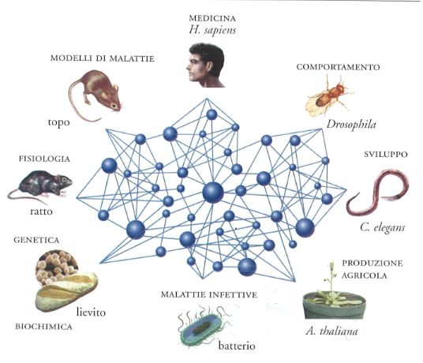
In terms of biomedicine, this master brings together all the available information of biological phenomena allowing to identify phenomena involved in the biomedical field that cannot be hypothesized a priori

Slide 11
ECTS distribution
The study plan (120 credits) includes some courses common to both programs in the first year, some optional courses to be chosen by the students (8 credits) and stages in laboratory (12 credits) and 19 (5 + 14) credits for experimental thesis

Slide 12
The main focus of this program is on practical experience, which the students gain during several internships. Students spend most of their formative curriculum attending the experimental work in a research laboratory that may lead to scientific publications. Lectures and seminars offered by the University of Torino are part of the formative track.

Slide 13
The main focus of this program is on practical experience, which the students gain during several internships. Students spend most of their formative curriculum attending the experimental work in a research laboratory that may lead to scientific publications. Lectures and seminars offered by the University of Torino are part of the formative track.

Slide 14
The program aims to produce researchers whose profound knowledge of the most advanced biotechnological applications enables them to independently address the most important basic and applied biomedical issues. As such, the graduates have all the theoretical knowledge and practical skills to access at international doctoral programs or to be considered for positions in pharma- and biotech- companies.

Slide 15
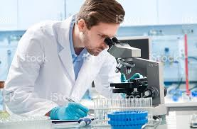
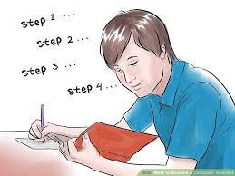
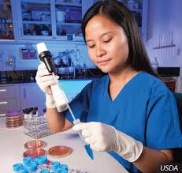

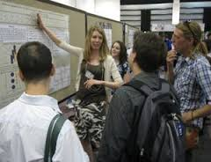
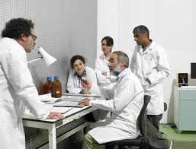
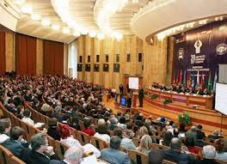
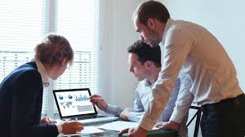
Thinking
Set and perform an experiment
SCIENTIST
Present data
Discuss data

Slide 16
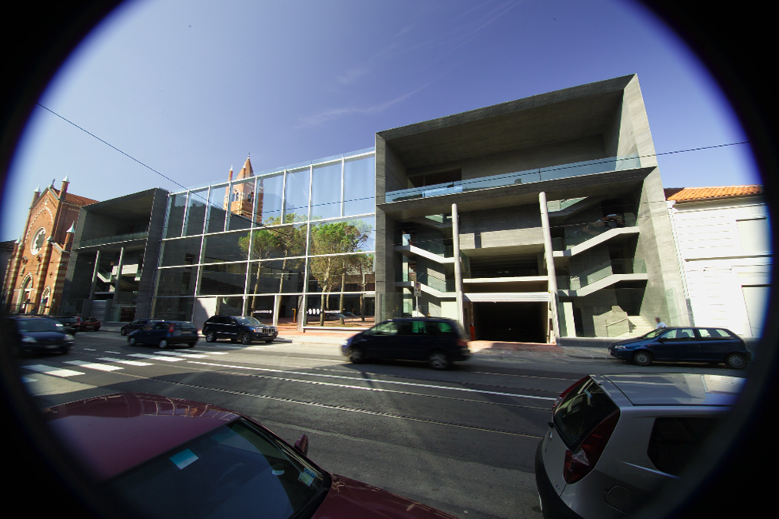
Lessons are held at Molecular Biotechnology Center (MBC)

Slide 18
Experimental thesis
Academia:
Molecular Biotechnology Center – MBC
Candiolo Cancer Institute – IRCCS
Neuroscience Institute Cavalieri Ottolenghi – NICO
CeRMS– Centro di Ricerca in Medicina Sperimentale
Industry:
Bioindustry Park Silvano Fumero, Colleretto Giacosa (TO) (Bracco, Merck-Serono)
DiaSorin
Chiesi Farmaceutici

Slide 19
International mobility
Erasmus program
Double Degree: Université Grenoble Alpes, UFR de Pharmacie
International Academic Exchange: University of Minnesota
COIL (Collaborative Online International Learning): Universidad San Paulo, Madrid E, University of Coventry UK

Slide 20
Admission
Basic computer skills (Microsoft office, internet navigation) and a minimum B2 English language level under the Common European Framework of Reference for Languages (CEFR).
2. First Level Degree (Bachelor Degree) providing a solid background in in General and Inorganic Chemistry, Organic Chemistry, Biochemistry, Cell Biology, Molecular Biology and Genetics.
The scientific background will be verified by a test and/or an interview.

Slide 21
Job opportunities
Industry: Biotech Companies, Pharma, Chemistry
Academia

Slide 22
Contacts
Website: http://www.molecularbiotechnology.unito.it/do/home.pl
Paola Defilippi: paola.defilippi@unito.it
Marina Marchisio: marina.marchisio@unito.it
Segreteria Didattica Biotecnologie: segdid.biotecmol@unito.it
Lucia Iannicella
Segreteria Studenti del Polo delle Scienze Mediche e delle Biotecnologie:
Corso Massimo d'Azeglio 60 - 10126 Torino
segrstu.chirurgia@unito.it

Slide 23
Grazie

